Slide 1

AI-Based Space Debris Detection
for Space Situational Awareness (SSA)
Submitted by: Aeman Chaudhary & Jannat Javed
Degree: BS Artificial Intelligence
Supervisor: Prof. Dr. Najia Saher

Slide 2
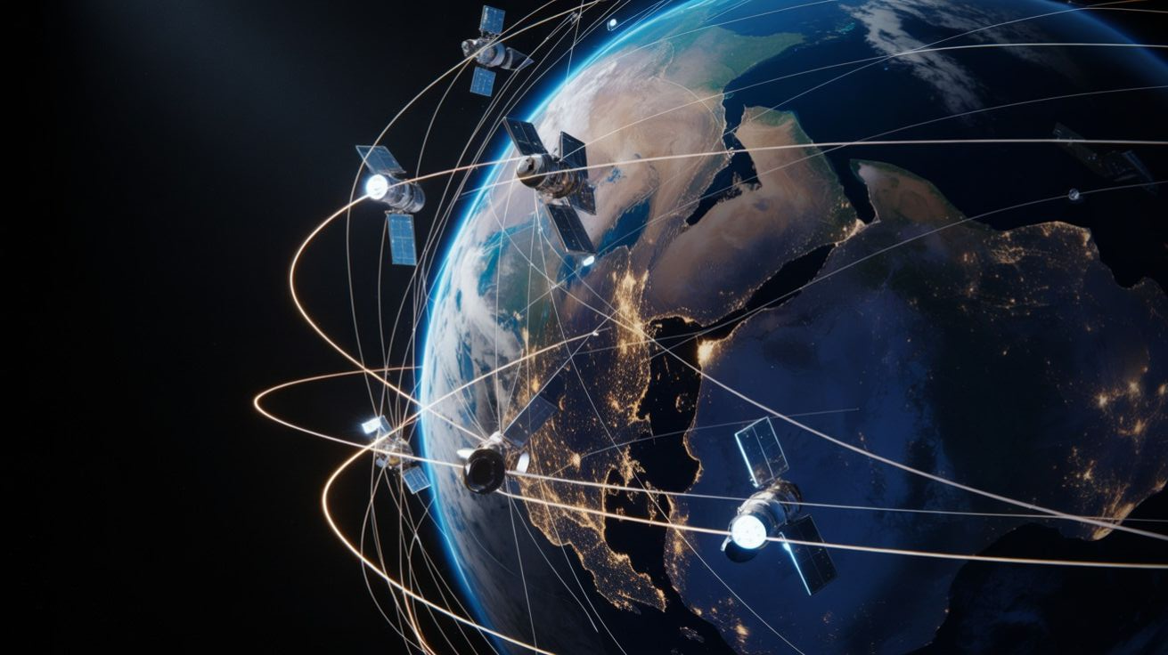
LEO Satellites
Low Earth Orbit (LEO) satellites circle the Earth at altitudes ranging from 160 km to 2,000 km. Due to their close proximity to Earth, they travel extremely fast (completing an orbit in 90 to 120 minutes) and are ideal for:
1) Global Internet Coverage – such as SpaceX’s Starlink
2) Earth Observation & Remote Sensing - for agricultural monitoring, climate science, disaster response, and military reconnaissance.
3) Scientific Research - The International Space Station (ISS) and various space telescopes reside in LEO

Slide 3
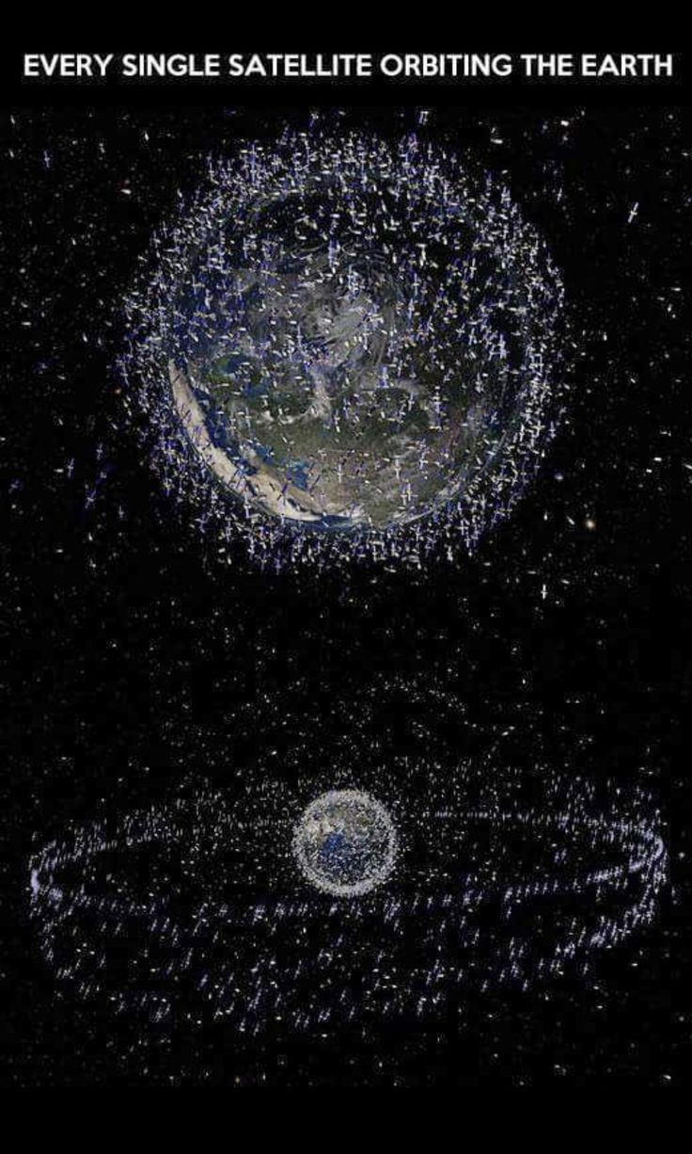

Slide 4
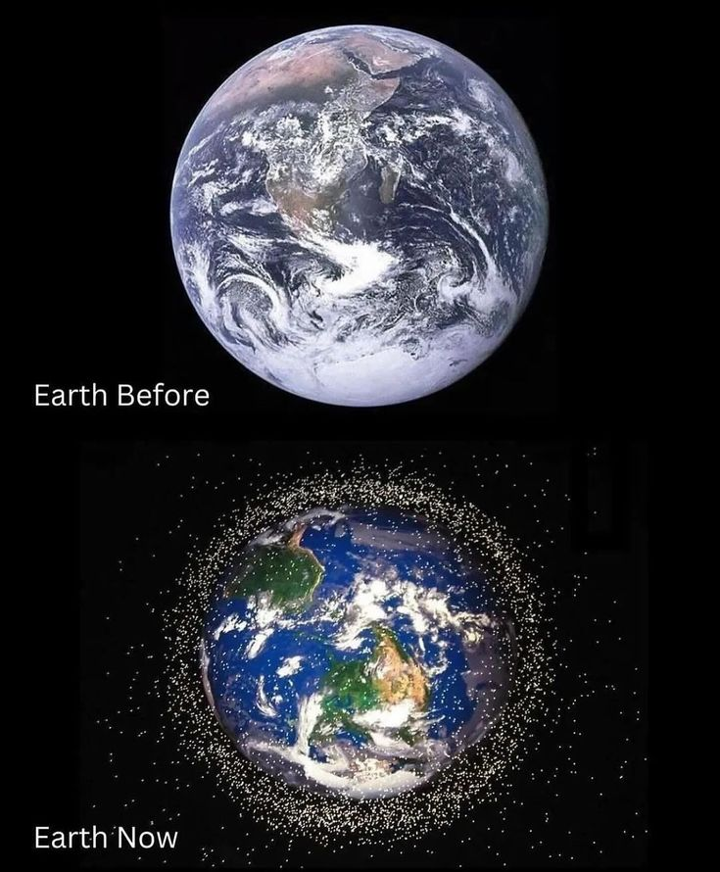
The Space Debris Crisis
LEO is the most populated region of space.
Debris = Dead satellites and space junk
Over 36,000 tracked debris objects orbit Earth.
And an estimated 130 million smaller, untrackable fragments.

Slide 5
The Kessler Syndrome
Debris travels at speed up to 28,000km/h, even a tiny paint fleck can cause significant damage to satellites.
Kessler syndrome: a scenario where collisions between objects generate even more debris.
This could eventually result in certain orbital paths becoming completely unusable.
Leading to severe economical and security threat to systems like GPS, Wifi (which we heavily rely on).

Slide 6
The solution? Collision Avoidance

Slide 7
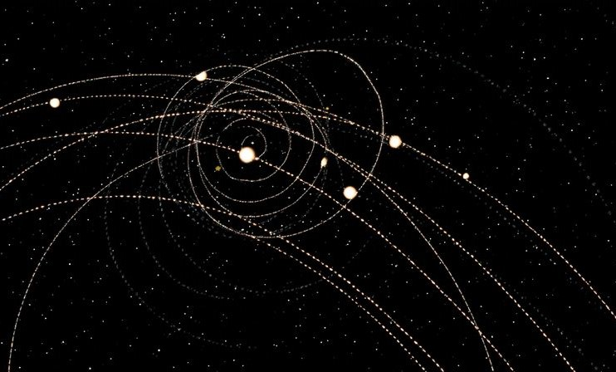
Our Project
Main modules:
Debris detection
Debris tracking
Collision risk prediction
3D simulation

Slide 8
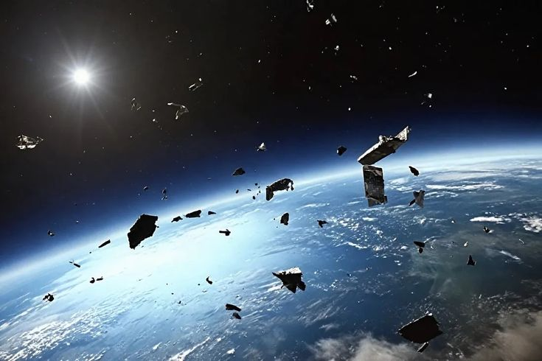
Objectives
Detect space debris using Computer Vision
Propagate orbital trajectories using TLE/OMM data
Assess collision risks of debris with our satellite
Visualize debris movement in a 3D environment

Slide 9
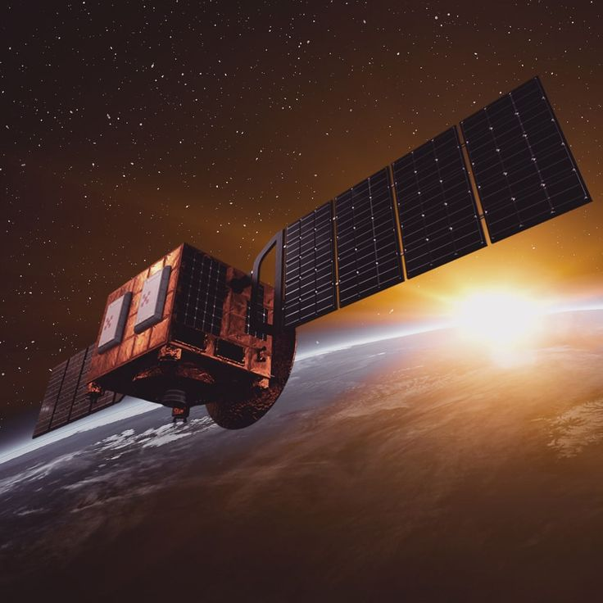
Data Sources
Debris detection:
AIcrowd space debris dataset (synthetic data, the best one out there)
Orbital tracking:
CelesTrak orbital data in TLE, OMM formats (real and latest data)
Reference technologies:
YOLO variants
SGP4 propagation model
Skyfield library
Flask

Slide 10
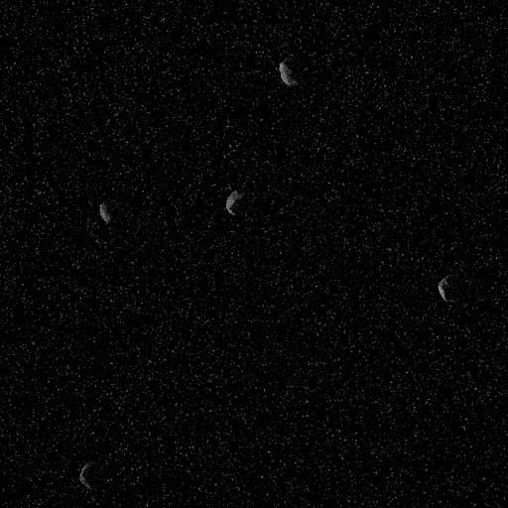
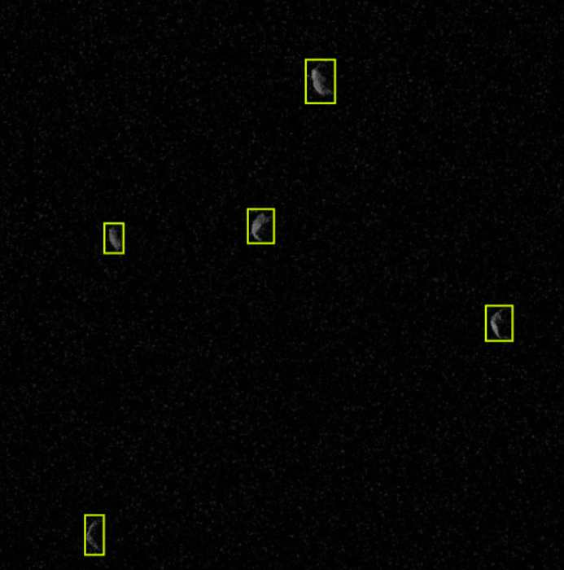
1) Debris Detection
Input: space imagery
Bounding box generation
Object detection
Tech stack:
Python
OpenCV
YOLO (v8n, v8s, v9c, v11s)

Slide 11
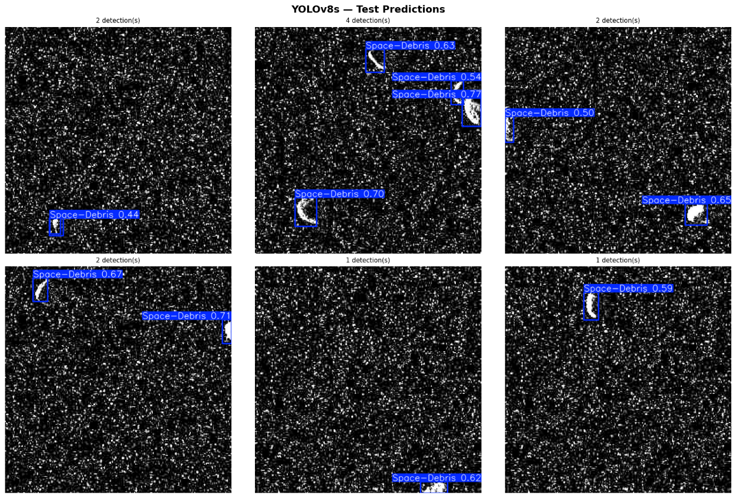
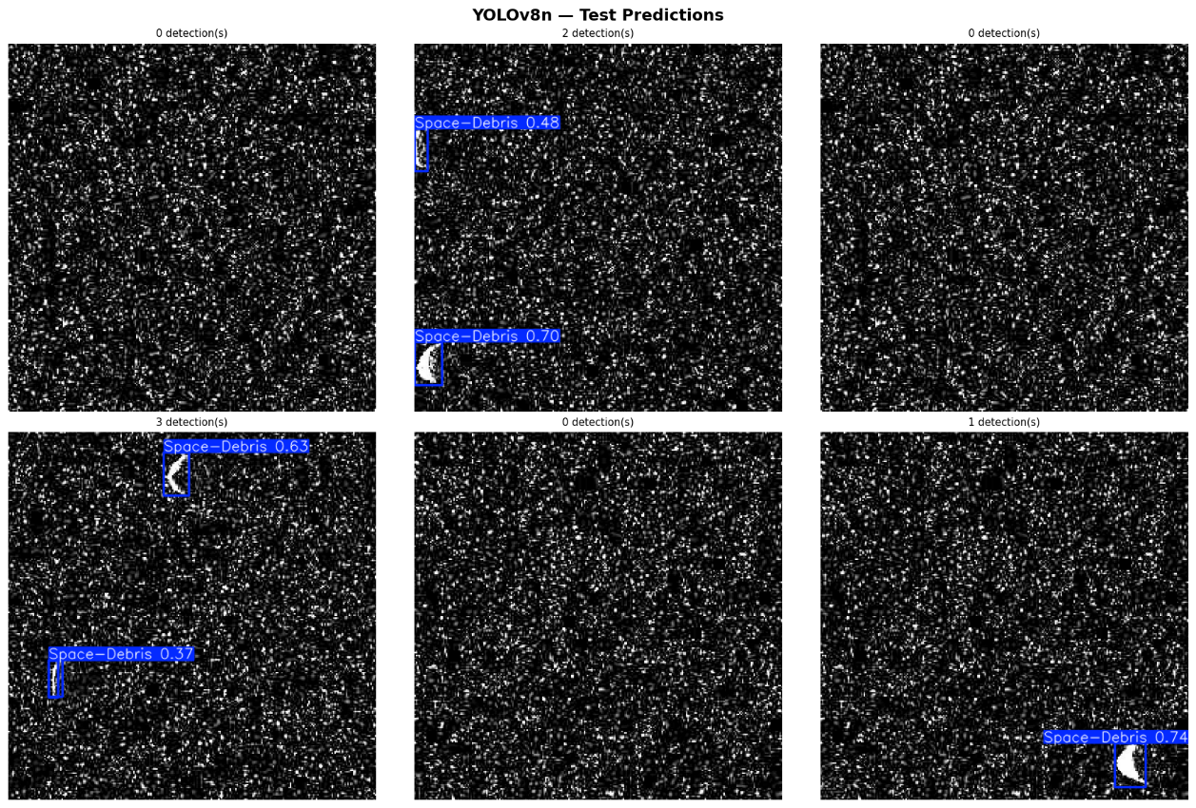
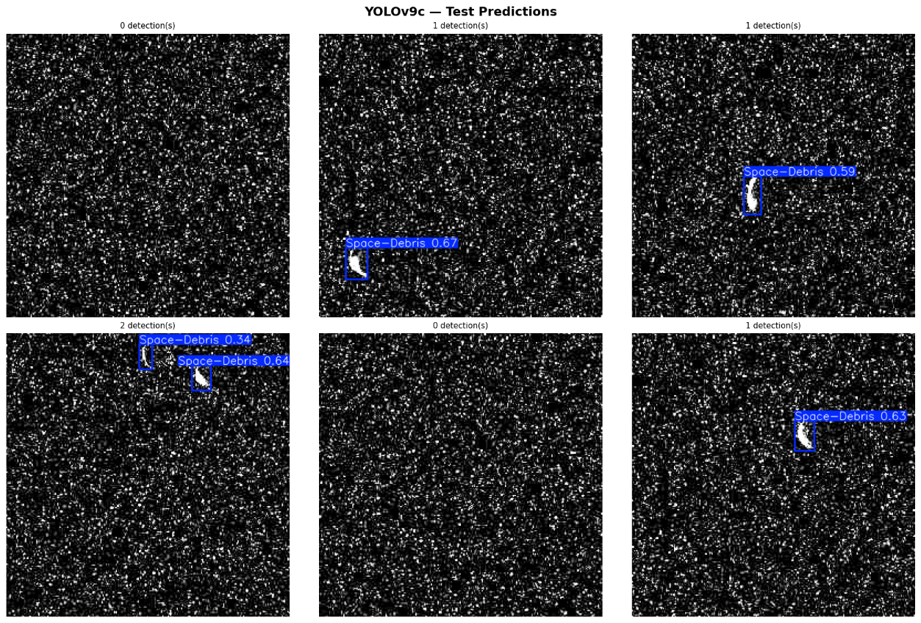
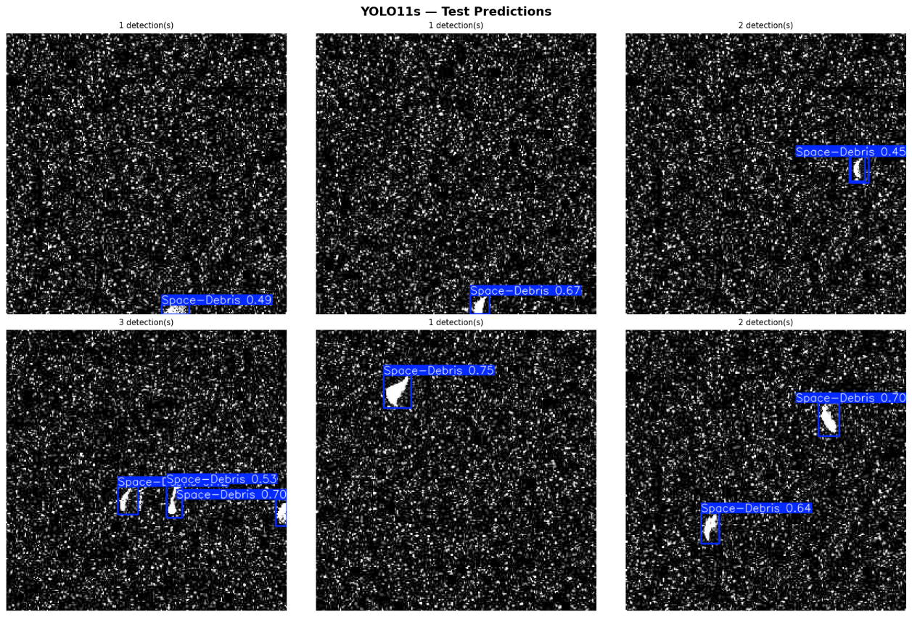

Slide 12
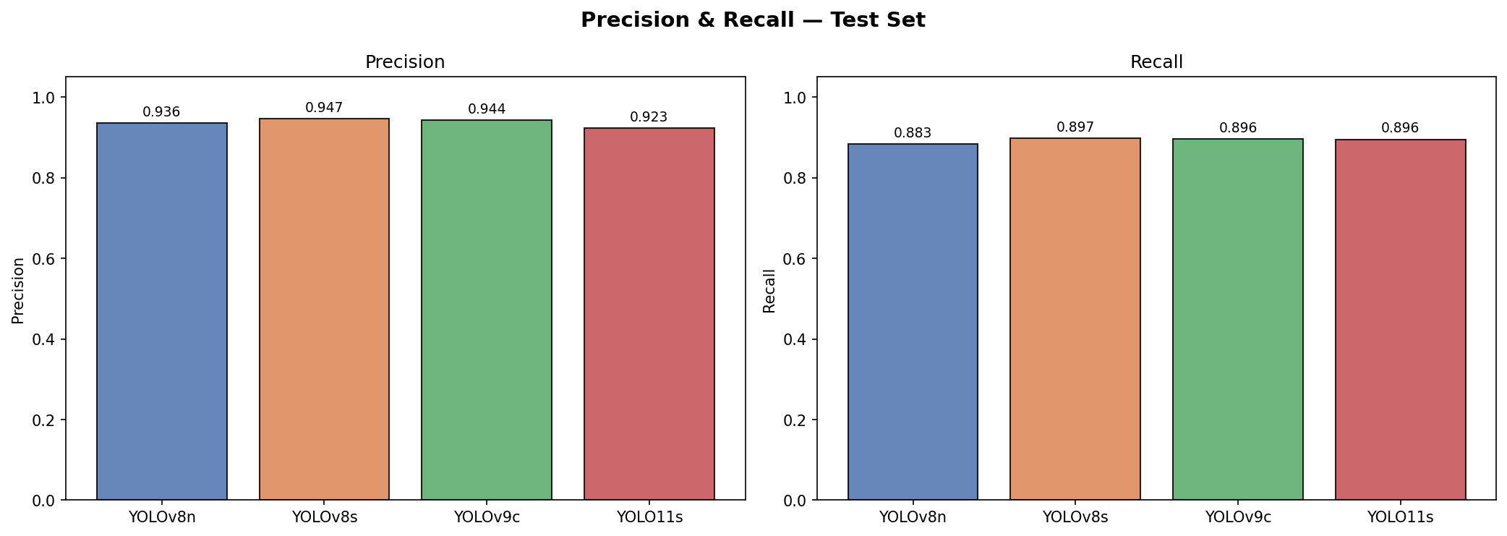
Best model: YOLO v8s

Slide 13
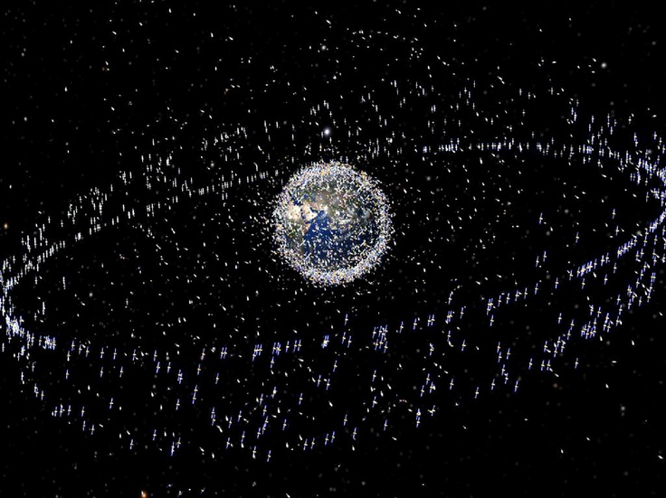
2) Debris Tracking
3 debris datasets combined together:
- Chinese ASAT Fengyun 1C
- Cosmos 2251
- Iridium 33
TLE data converted into orbital trajectories using SGP4 model.
Output:
- x, y, z coordinates
- time based orbital positions

Slide 14

3) Collision Risk Prediction
Now we calculate the distance between our main satellite (PRSS-1) and debris.
Using Euclidean distance formula:
Compute distances
Identify close approaches (within a certain threshold)
Generate collision alerts

Slide 15
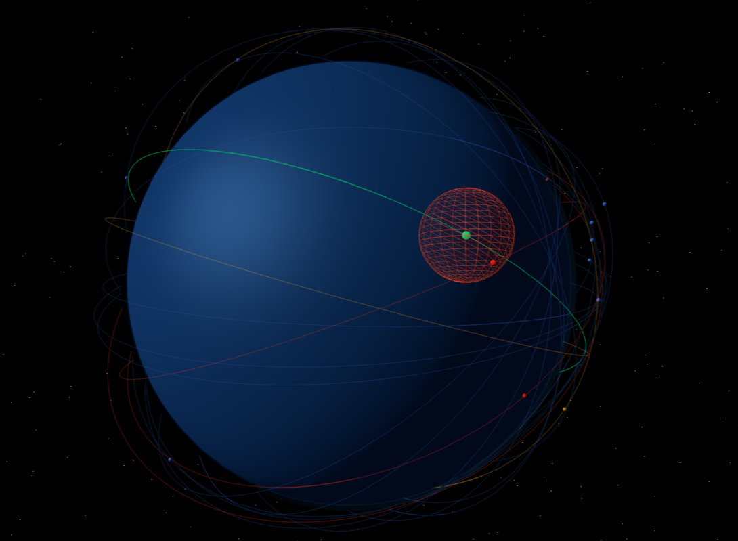
3D SSA Simulation
Earth-centered visualization
Satellite orbit visualization
Debris trajectory visualization
Collision threat highlighting
Interactive simulation
This is a screenshot from our simulation : )

Slide 16

Limitations
No real time satellite telemetry
Limited debris datasets
Not commercially deployable yet.
We did our best.

Slide 17
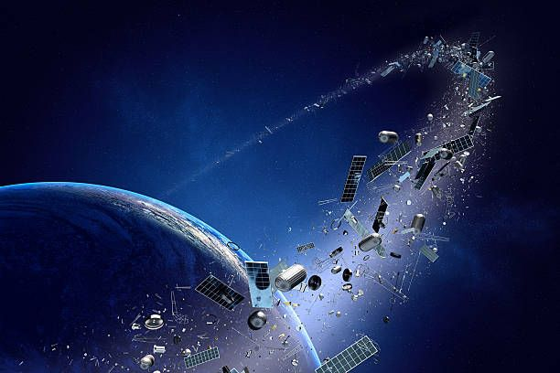
Future work
Real-time satellite tracking
Larger debris datasets
Enhanced AI detection models
Integration with national SSA initiatives

Slide 18
Key Takeaway?
Most satellites use sensors to detect debris.
Sensors can only detect ‘already known debris’
Cameras, on the other hand, can detect ‘new type of debris’
But
Space is dark -> the image quality is usually not so good.
So we train AI models to work alongside sensors.
Its not replacement. Its enhancement.

Slide 19
Thank you

